Slide 1
뉴스/SNS 데이터 분석 및 딥러닝을 이용한 주가예측
현대 해상
광운코인 - 이동준(팀장), 이세영, 장성록, 박덕영, 권 민

Slide 2


Title / Team
Title : 뉴스/SNS 데이터 분석 및 딥러닝을 이용한 주가예측
With 현대해상
Team - 광운코인
Leader : 이동준
Members : 권 민, 박덕영, 이세영, 장성록
Professor : 이기훈

Slide 3
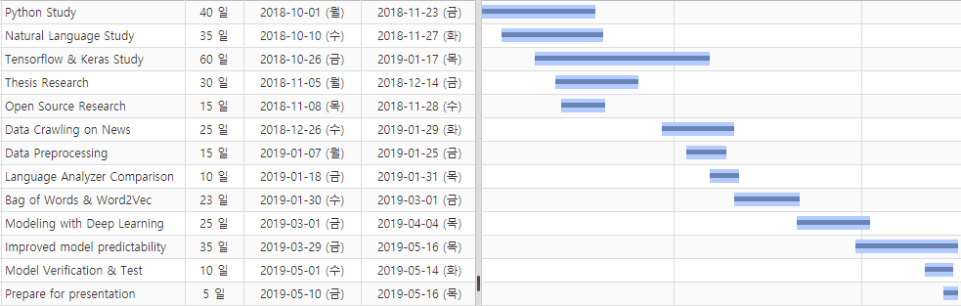
Project Progress
Project Start Date : 2018-10-01
Planned data of completion : 2019-05-16
Actual data of completion : 2019-05-16

Slide 4
Objective in the project proposal
Find the relationship between news/twitter and stocks
evaluation : Data collection based on understanding of stocks
Creating Theme-Stocks Prediction model
evaluation : Create a module based on North Korea
Performance Indicator
1. Accuracy
2. F1 Score
evaluation :
Target performance figures : 70% ↑
evaluation :
Provide web application to show project related information
evaluation :

Slide 5
Overall of Program
Preprocess
normalization
News & Twitter Crawling
Organized by learning data
Create model
tokenization
Stopword Removal
learning data(~2018)
<Positive & Negative Index>
1 - Daily stock price point value increased by 1%
0 - Daily stock price point value decreased by 1%
Model
action
Application
Evaluation data(2019~)
Preprocess
normalization
Evaluate preprocessed data
tokenization
Stopword Removal
<Positive & Negative Index>
1 - Daily stock price point value increased by 1%
0 - Daily stock price point value decreased by 1%
Red Line - Model creation process using learning data
Blue Line - Evaluation of Prediction Rate of Model Using Evaluation Data

Slide 6
News Data
Crawling on the Chosun ilbo
Theme Stock : North Korea
Collection period : 2011.11.18 ~ 2019.03.04
Method : 3 consecutive days or more than 4% rise and fall
Only news in politics
Total 5549 News of time series data divided into 3 : 3 : 4
Train Data : Validation Data : Test Data = 8 : 1 : 1

Slide 7
Data processing
Normalization
re module of sub to remove the meaningless words.
Stopword Removal
Stopword dictionary into a text file and remove unnecessary words such as “것, 그리고, 하는 ... “
Mecab-ko
The separated words have to combine after the analysis
d

Slide 8
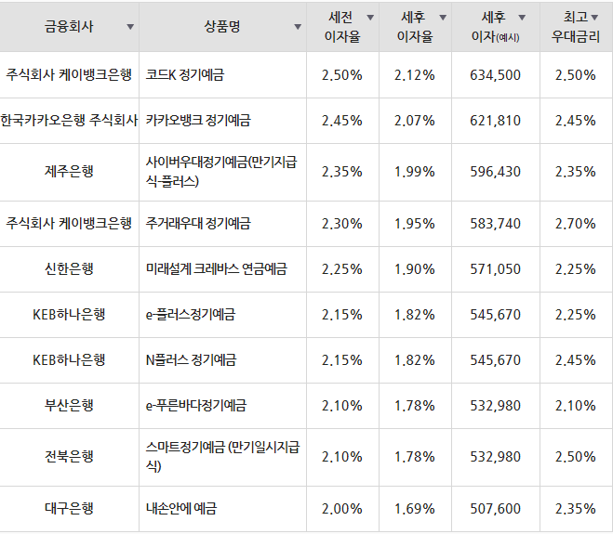
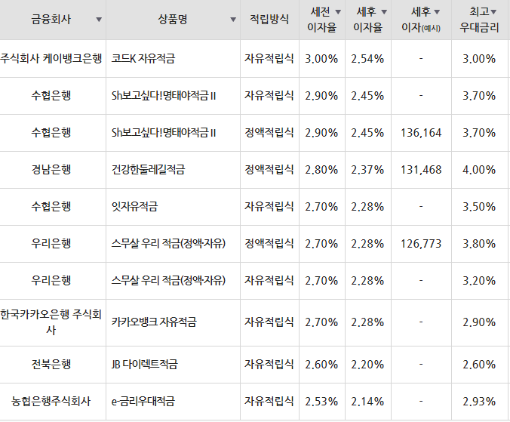
[1-A] Background & Necessity(banking product)
[Table-1] Interest rate deposits by bank
[Table-2] Interest rate periodical deposits by bank
Top 10 products based on 3 years
Maximum interest rate deposits 2.5%
Maximum interest rate periodical deposits 4.0%
* Excluding Saving banks

Slide 9
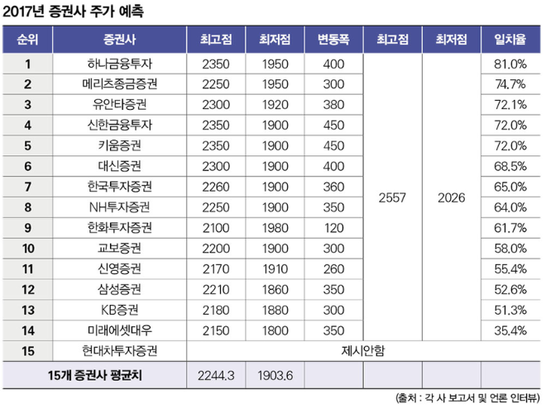
[1-A] Background & Necessity(securities firm)
Only the top five securities firms have a concordance rate of more than 70%
For the highest agreement rate, 81%
No suggestions for Hyundai
[Table-3] Status of Stock price forecasts by securities firms

Slide 10
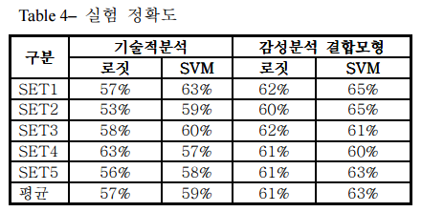
[1-A] Background & Necessity(relation study)
Sentimental Analyzing using Bag of words and Word2Vec
Machine learning Algorithm + ANN
[Table-4] is checked, the maximum degree of prediction is 65%
[Table-4] Prediction rate of thesis research
Differences
Study based on deep learning using ANN, RNN, LSTM, and GRU after Sentimental Analyzing dictionary construction
Using Various Analyzers(Okt, mecab, Espresso, NLTK)

Slide 11
[2-A] Schedule(Budget plan)
Material : Computer Upgrade(RAM, GPU)
literature : Purchase project-related theory books
Office supplies : Writing material, file book
Dining & refreshments : cost of dining after the meeting and Refresh cost to be used during the meeting

Slide 12
[2-A] Schedule(performance plan)

Slide 13
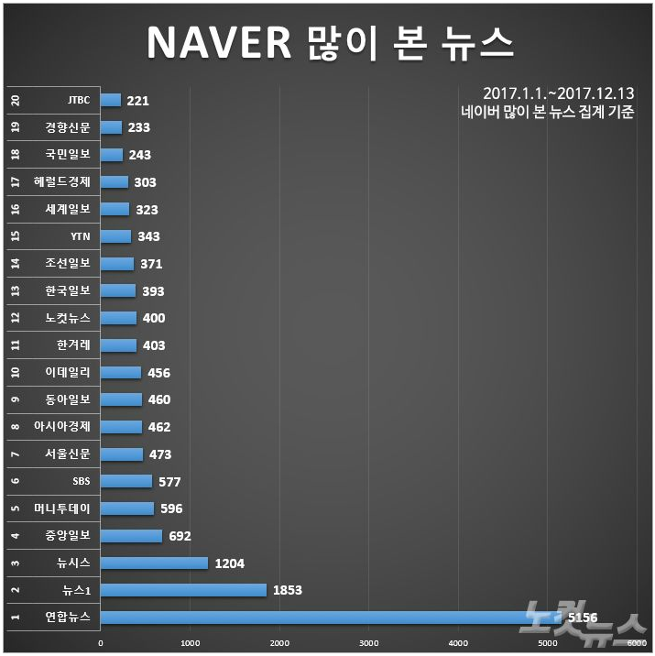
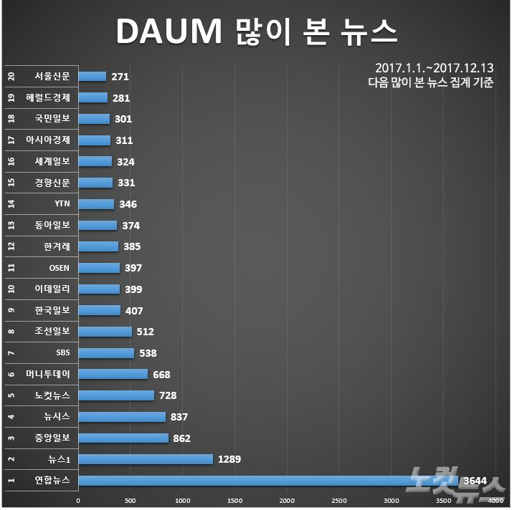
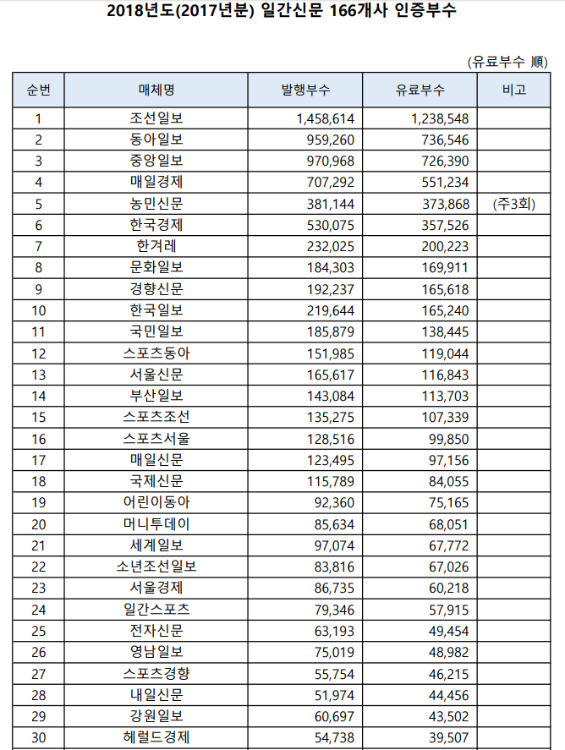
[2-C] Detail design (News & Twitter Crawling)
[Table-6]
Paid to issue of daily newspaper by press
[C-1]
Main portal site Internet news ranking
1. Crawling on the Chosun ilbo site.
* Provide articles of Yonhap News
2. In the case of Crawling, use BeautifulSoup of Python

Slide 14
[2-C] Detail design(Data preprocessing)
1. Normalization
- re module of sub to remove the meaningless words.
**re is the module that python provides for regular expressions
2. Stopword Removal
- Stopword dictionary into a text file and remove unnecessary words such as “것, 그리고, 하는 ... “
- Using open function and “if”, we will remove

Slide 15
[2-C] Detail design (Data preprocessing - Tokenization)
Korean analyzer
1. Mecab-ko
- Version ported to use Japanese analyzer mecab in Korean.
- Referring to the dictionary.
- The separated words have to combine after the analysis.
2. Okt(Open Korea text), (twitter in the past)
- Sentence is analyzed more broadly because the pos tag is the smallest.
- Difficult to analyze if the spacing is not good.
3. Espresso
- Better result of proper nouns and compound nouns analysis.
- Not suitable for analysis when the spacing is not good or sentiment analyzing.
- The particle words may not be removed.
English analyzer
1. Nltk
- Nltk is provides easy-to-use interfaces to over 50.
- Supporting the classification, tokenization, prohibition, tagging, parsing, etc.

Slide 16

[2-C] Detail design (Data preparation & create model)
Data preparation
Document summary
* Text rank
- Using frequency of words, different weight of words
Implementing learning data
* Bag of Words
- Without order, Consider frequency of words
* Word2Vec
- To consider the similarity between words, vectorize the meaning of words
Model creation
* Keras
- It is a Python-based open source neural network that can be run on Deep Learning such as Tensorflow, CNTK.
- Provides a consistent and simple API
- Minimize the number of user tasks

Slide 17
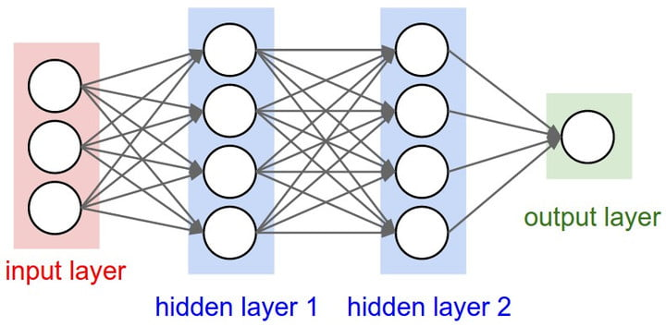
[2-C] Detail design (Deep Learning-ANN)
ANN(Artificial Neural Network)
- A network composed of artificial Neurons
- One of the detailed methodologies of Deep Running
- SOM, RNN, CNN
- Only input layer, hidden layer, output layer

Slide 18
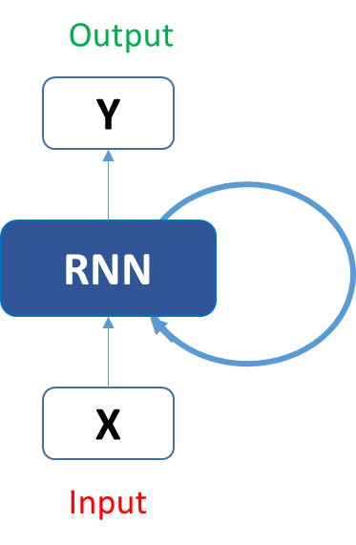
[2-C] Detail design (Deep Learning-RNN)
RNN(Recurrent Neural Network)
- Using memory to handle a series of inputs
- Sequential
- News/SNS sentence analysis
Recurrent Learning in the Hidden Layer
But, Long-Term Dependency “Problem”
Substitution through LSTM
Google Image

Slide 19
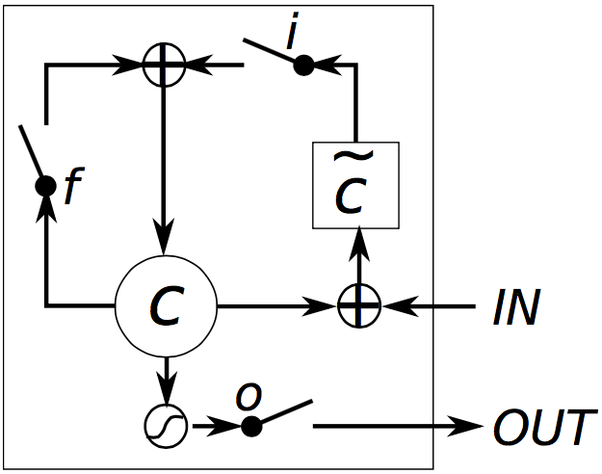
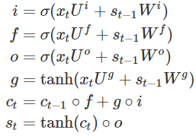
[2-C] Detail design (Deep Learning-LSTM)
[P-3] LSTM
[F-1] LSTM Formula
LSTM(Long Short-Term Memory)
- Solution of RNN problems
- Input gate, output gate, forget gate
* Input gate: Determine how much input vector value to use in calculating new hidden state value
* Output gate: Determines how much of the internal state value can be seen outside the LSTM module
* Forget gate: Determines how many previous state values ​​to remember
- User can easily apply in Keras

Slide 20
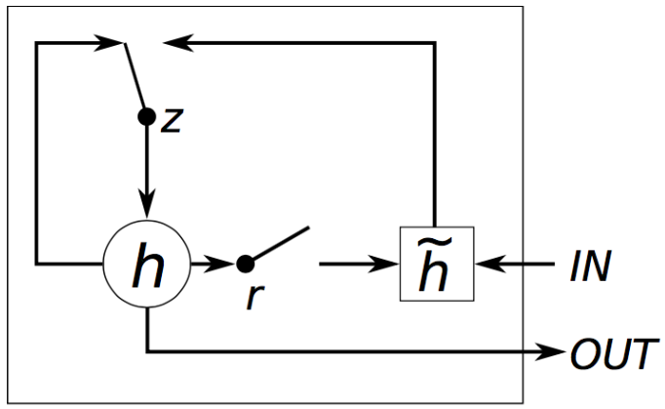
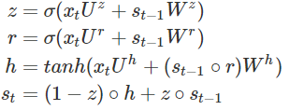
[2-C] Detail design (Deep Learning-GRU)
[P-4] GRU
[F-2] GRU Formula
GRU(Grated Recurrent Unit)
- No additional nonlinear functions are applied when calculating output values.
- Reset gate and Update gate.
* Reset gate: Determines how the new input and previous memory values ​​are combined
* Update gate: Determines how much memory is remembered
- Short learning time, Possible learn using less data
* LSTM may show better results if there is enough data
- It is easy for users to apply in Keras

Slide 21

[2-C] Detail design (Web application)
https://spring.io/
Using spring framework, make web application
Show real-time stock price
Show prediction output
Open source application framework for the Java platform
It provides various services for developing dynamic websites

Slide 22
[3-A] Expected Effect & Using Plan
Expected Effect
1. Information on company preference and reliable stock information.
2. Develop investment products
3. The higher the accuracy of forecasting, get the better interest rate
Using Plan
1. Improve direction and identify industry
2. When the prediction rate is good, Real invest using Company API

Slide 23
[3-B]Reference
Chart & Table
[C-1] CBS노컷뉴스 박기문 기자(https://www.nocutnews.co.kr/news/4895463)
[Table-1] [Table-2] 금융감독원(금융상품 한눈에)
[Table-3] 각 사 보고서 및 언론 인터뷰
[Table-4] 한국 ABC 협회
[Table-5] 뉴스 감성분석과 SVM을 이용한 S&P 500 주가지수 예측(차은정, 홍태호)
Site
[site-1] https://wikidocs.net/book/2155 - 딥 러닝을 이용한 자연어 처리 입문
[site-2] http://www.kabc.or.kr – 한국 ABC협회
[site-3] https://konlpy-ko.readthedocs.io/ko/v0.4.3 – KoNLPY : 한국어 NLP
[site-4] http://eunjeon.blogspot.com – Mecab
[site-5] https://tykimos.github.io/DeepBrick - Keras
Formula
[F-1] [F-2] http://aikorea.org/blog/rnn-tutorial-4 – LSTM, GRU 수식

Slide 24
[3-B]Reference
Picture
[P-1] 뉴스 감성분석과 SVM을 이용한 S&P 500 주가지수 예측(차은정, 홍태호)
[P-2] 뉴스 감성분석과 SVM을 이용한 S&P 500 주가지수 예측(차은정, 홍태호)
[P-3] LSTM Gating. Chung, Junyoung, et al. “Empirical evaluation of gated recurrent neural networks on sequence modeling.” (2014)
[P-4] GRU Gating. Chung, Junyoung, et al. “Empirical evaluation of gated recurrent neural networks on sequence modeling.” (2014)
[P-5] RNN Gating. Analytics Vidhya www.analyticsvidhya.com/blog/2017/12/introduction-to-recurrent-neural-networks/rnn-neuron/
[P-6] ANN Gatring. DIGITAL TRENDS “What is an artificial neural network?” by Luke Dormehl(2019)
Thesis
[T-1] 뉴스와 주가: 빅데이터 감성분석을 통한 지능형 투자의사결정 모형(김유신, 김남규, 정승렬)
[T-2] 산업군 내 동질성을 고려한 온라인 뉴스 기반 주가예측(성노윤, 남기환)
[T-3] 온라인 언급이 기업 성과에 미치는 영향 분석: 뉴스 감성분석을 통한 기업별 주가예측(정지선, 김동성, 김종우)
[T-4] 인터넷 뉴스 빅데이터를 활용한 기업 주가지수 예측(유지돈, 이익선)
[T-5] 뉴스 텍스트 마이닝과 시계열 분석을 이용한 주가예측(안성원, 조성배)
[T-6] 카테고리 중립 단어 활용을 통한 주가예측 방안: 텍스트 마이닝 활용(이민F, 이홍주)
[T-7] 주가지수 방향성 예측을 위한 주제지향 감성사전 구축 방안(유은지, 김유신, 김남규, 정승렬)
[T-8] SNS와 뉴스기사의 감성분석과 기계학습을 이용한 주가예측 모형 비교 연구(김동영, 박제원, 최재현)
[T-9] 뉴스 감성분석과 SVM을 이용한 S&P 500 주가지수 예측(차은정, 홍태호)
[T-10] 웹 뉴스 텍스트 마이닝을 이용한 주가 등락 예측(최일지)

Slide 25
Q & A

